Slide 1
How can we support
ELL students institutionally?

Slide 2
Creating a Welcoming School

Slide 3
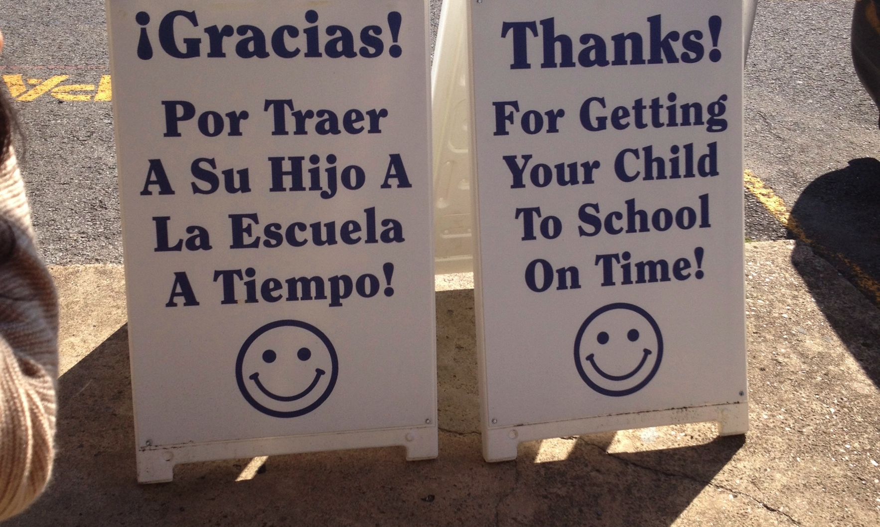
Post signs in multiple languages.

Slide 4
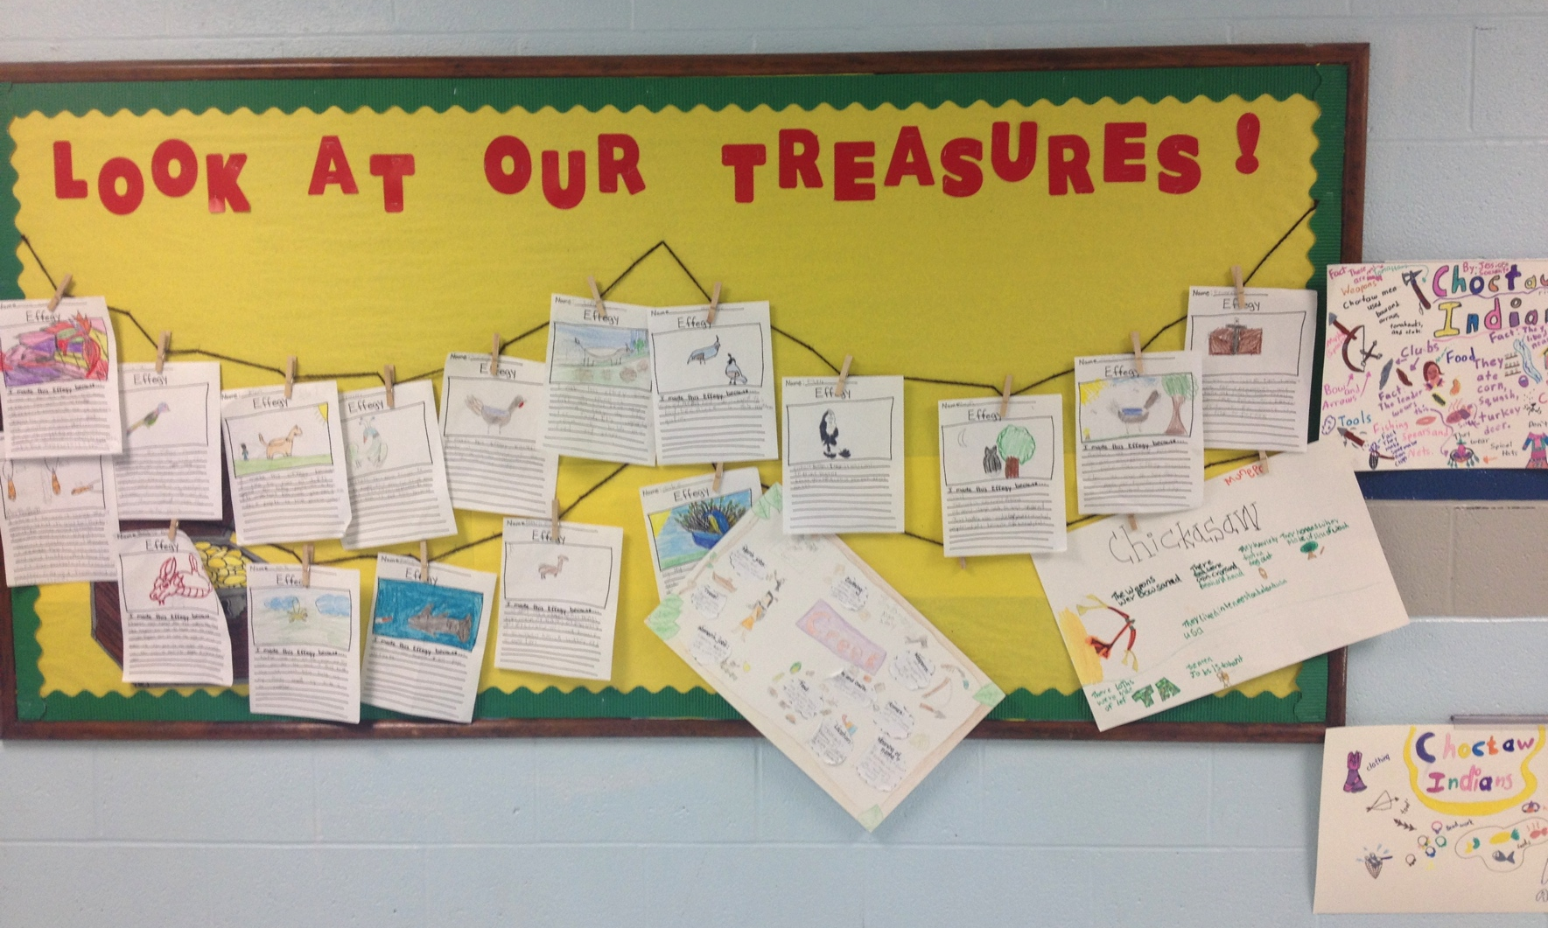
Display students’ work on the walls

Slide 5
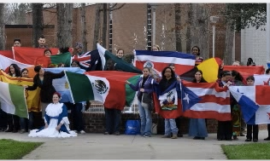
Display the maps and flags of the students' native countries.

Slide 6
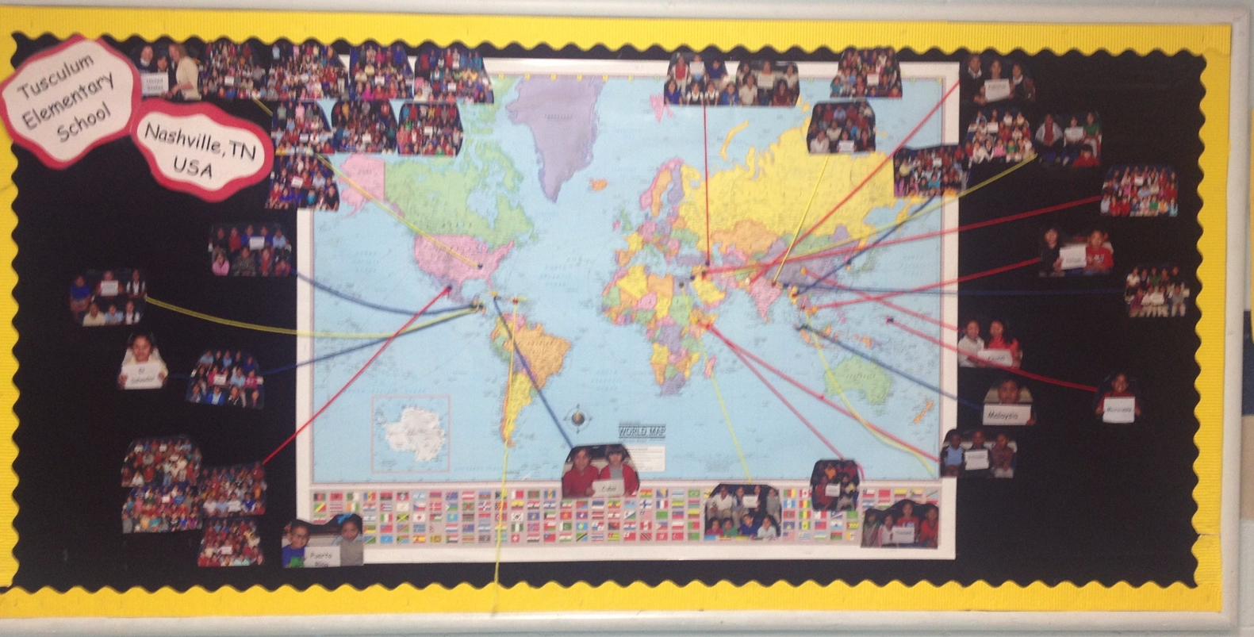
Display a large map in the front lobby where parents can mark their native countries with a pin

Slide 7
Know our ELL Students
Age
Native Language
Literacy of Parents
Reason for Immigrating

Slide 8
Getting Families Involved
Getting to know ELL families helps build an important relationship based on trust, which in turn can pave the way to student success.
Indeed, many ELL families have come to this country with the hopes of offering their children a better future, and they are eager to talk with their children's teachers about what they can do to help their children in order to be successful.

Slide 9
Culturally Relevant Teaching

Slide 10
Respect cultural differences
Educate ourselves about our students’ cultures
Incorporate these knowledge to reshape the curriculum

Slide 11
Ways WE will incorporate Culturally Relevant Teaching:
WE will…
not compare students or show favoritism
be creative with teaching strategies
respect our students because they will notice
teach our students about their culture
not follow stereotypes or make assumptions

Slide 12
Differences are made by promoting:
Bilingualism
Biculturalism
Biliteracy

