Slide 1
INTRODUCTION TO DYNAMIC ASSESSMENT
H. Carl Haywood, PhD
Professor of Psychology, emeritus
Vanderbilt University

Slide 2
Dynamic Assessment is
An interactive approach
To psychoeducational assessment
Of learning potential
That involves
  Teaching within the test
  Pre-post assessment
  Mediational teaching
  Intraindividual comparisons
  Estimation of effective teaching/learning strategies
  Identification of obstacles to effective learning

Slide 3
Some Definitions
◘ Assessment vs measurement
◘ Dynamic vs static
◘ Intelligence, IQ, latent and manifest variables
◘ Learning potential, performance
◘ Intelligence and cognitive processes: Distinction
◘ Mediation

Slide 4
Critical Dimensions of Psychoeducational Assessment
What does one wish to assess?
Essential comparisons
  Subject with norms
  Subject with self
    Over time
    Same time, different abilities or performances

Slide 5
Why do we need a different form of assessment?
Psychologists frequently argue that IQ does not reflect intelligence or learning potential accurately. Error always unidirectional.
Persistent claims of gender, racial, ethnic, and disability biases (evidence weak)
Failure of intelligence-based views of the nature of ability
Poor prediction of school achievement; differential predictive value
Classification is an inadequate objective. How to defeat negative predictions?
As a research tool, they are inadequate to reach much elusive information

Slide 6
Estimation of Learning Potential
Vygotsky’s observations, children from “the republics”
How one learns must affect effectiveness and efficiency of learning
Search for
  ..what could happen, given X treatment, rather than
  ..what will happen, given no special treatment

Slide 7
Assumptions of DA
Potential is always better than performance
There are treatable obstacles to learning and performance
Potential can be revealed if obstacles are removed or minimized
Identifying and minimizing obstacles often requires giving help
  Reducing cognitive developmental barriers
  Reducing “artificial” barriers, e.g., ignorance, language, inexperience, resistance

Slide 8
Comparison of Dynamic and Static/Normative Assessment
What is compared
  Self with norms vs self with self
Major questions
  What is known or not known vs what can be learned
Examining process
  Objective vs interactive
Interpretation of results
  ID of limits on performance vs ID of obstacles and ways to overcome them (learning potential)
Role of examiner
  Poses problems, records, affectively neutral vs teaches, promotes change, affectively involved

Slide 9
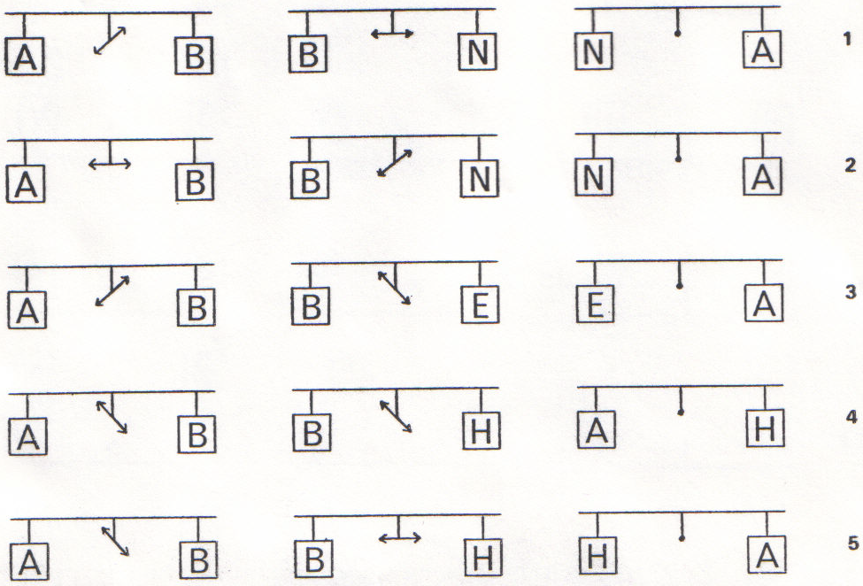

Slide 10
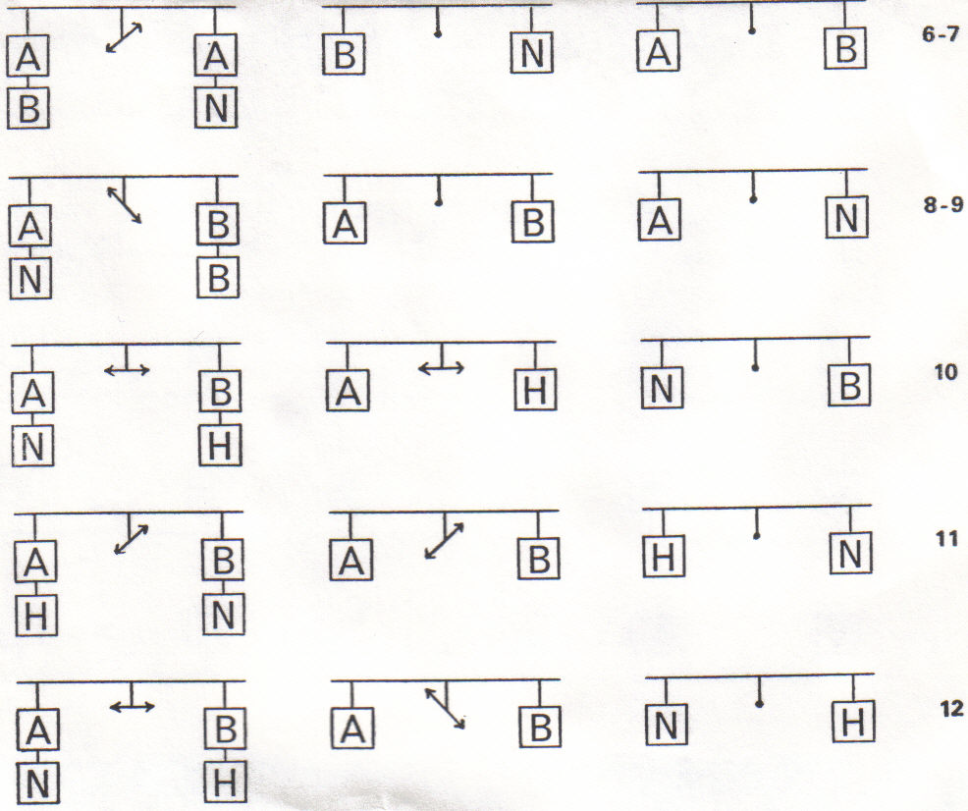

Slide 11
Analytic Questions
What knowledge do you need to have in order to be good at solving these problems?
What cognitive and metacognitive abilities and/or habits seem to be called upon in these problems?
What non-cognitive (emotional, motivational, attitudinal, dispositional) characteristics could affect performance on these problems?

Slide 12
Procedural Questions
What apparent obstacles are interfering with performance?
How can I overcome the obstacles without telling the answers? (What mediation?)
How does the subject respond to my mediation/help?
How can I assess the possibility of transfer of rules, concepts, strategies, knowledge?

Slide 13
Interpretation Questions
What was initial performance? High, low, consistent across problems..?
What was the difference between initial performance and performance following mediation?
What kinds of mediation, and how much of it, yielded performance improvement?
What were the major obstacles to performance, and how can they be overcome?

Slide 14
The Flags Test
1. If flag number 1 were red and white, there would be one color too many. If that flag were green and white, there would still be one color too many. Flag number 1 is ­­­­____________.
2. If flag number 2 were green and gray, there would be one color too many. If that flag were green, yellow, and white, there would be two colors too many. Flag number 2 is ____________.
3. If flag number 3 were blue and black, there would be one color too many. If that flag were black, red, and green, there would be two colors too many. Flag number 3 is ­­____________.
4. If flag number 4 were yellow and blue, there would be one color too many. If that flag were blue and green, there would be one color too many. If it were red and blue, there would be one color too many. Flag number 4 is
____________.
5. If flag number 5 were red, green, and yellow, there would be two colors too many. If that flag were yellow, blue, and black, there would be two colors too many. Flag number 5 is ____________.
6. If flag number 6 were green, there would be two colors missing. If that flag were black, there would be two colors missing. If it were red, there would be two colors missing. Flag number 6 is
____________.

Slide 15
16. If flag number 16 were black, blue, and green, there would be two colors too many. If that flag were red, blue, and green, there would be three colors too many. If it were blue, red, and black, there would be two colors too many. Flag number 16 is
____________.
17. If flag number 17 were green and blue, there would be one color missing. If that flag were black and green, there would be one color missing. If it were black and blue, there would be one color missing. Flag number 17 is
____________.
17. If flag number 17 were green and blue, there would be one color missing. If that flag were black and green, there would be one color missing. If it were black and blue, there would be one color missing. Flag number 17 is
____________.
18. If flag number 18 were black and green, there would be one color too many and one color missing. If that flag were yellow and red, there would be one color too many and one color missing. If it were black and red, there would be two colors too many and two colors missing. Flag number 18 is
____________.
19. If flag number 19 were green and yellow, there would be two colors too many and one color missing. If that flag were blue, red, and green, there would be two colors too many. If it were yellow, red, and green, there would be two colors too many. Flag number 19 is
____________.
20. If flag number 20 were green, black, and blue, there would be one color too many. If that flag were blue, red, and yellow, there would be two colors too many and one color missing. If it were black, yellow, and red, there would be two colors too many and one color missing. Flag number 20 is
____________.

Slide 16
Analytic Questions
What knowledge do you need to have in order to be good at solving these problems?
What cognitive and metacognitive abilities and/or habits seem to be called upon in these problems?
What non-cognitive (emotional, motivational, attitudinal, dispositional) characteristics could affect performance on these problems?

Slide 17
Procedural Questions
What apparent obstacles are interfering with performance?
How can I overcome the obstacles without telling the answers? (What mediation?)
How does the subject respond to my mediation/help?
How can I assess the possibility of transfer of rules, concepts, strategies, knowledge?

Slide 18
Interpretation Questions
What was initial performance? High, low, consistent across problems..?
What was the difference between initial performance and performance following mediation?
What kinds of mediation, and how much of it, yielded performance improvement?
What were the major obstacles to performance, and how can they be overcome?

Slide 19
1. Yellow - Brown
2. April - June
3. Rolls - Toast
4. Robin - Swallow
5. Baseball - Football
6. Snow - Glacier
7. Tulips - Roses
8. Fly - Ant
9. Flashlight - Sun
10. Floor - Room
11. Snake - Iguana
12. Planet - Star
13. Cow - Chicken
14. Brain - Heart
15. String - Press
16. Mop - Vacuum cleaner
17. Lawyer - Doctor
18. Market - Kitchen
19. Jar - Box
20. Lake - River

Slide 20
1. Yellow - Brown - Green - Purple - Orange
2. April - June - February - July - September
3. Rolls - Toast - Biscuits - Muffins - Buns
4. Robin - Swallow - Eagle - Chickadee - Cardinal
5. Baseball - Football - Tennis - Bowling - Golf
6. Snow - Glacier - Iceberg - Sleet - Hail
7. Tulips - Roses - Carnations - Lilies - Violets
8. Fly - Ant - Grasshopper - Mosquito - Bee
9. Flashlight - Sun - Match - Lamp - Moon
10. Floor - Room - Chimney - Roof - Wall
11. Snake - Iguana - Alligator - Chameleon - Crocodile
12. Planet - Star - Sun - Comet - Moon

Slide 21
Analytic Questions
What knowledge do you need to have in order to be good at solving these problems?
What cognitive and metacognitive abilities and/or habits seem to be called upon in these problems?
What non-cognitive (emotional, motivational, attitudinal, dispositional) characteristics could affect performance on these problems?

Slide 22
Procedural Questions
What apparent obstacles are interfering with performance?
How can I overcome the obstacles without telling the answers? (What mediation?)
How does the subject respond to my mediation/help?
How can I assess the possibility of transfer of rules, concepts, strategies, knowledge?

Slide 23
Interpretation Questions
What was initial performance? High, low, consistent across problems..?
What was the difference between initial performance and performance following mediation?
What kinds of mediation, and how much of it, yielded performance improvement?
What were the major obstacles to performance, and how can they be overcome?

Slide 24
PROVERBS, Form A
1. *No use crying over spilled milk.
You can’t un-ring the bell.
No use locking the barn door after the horse has been stolen.
2. Beauty is only skin-deep.
*Don’t judge a book by its cover.
All that glitters is not gold.
3. *Actions speak louder than words.
Deeds are fruits; words are but leaves.
The tree is known by its fruit.
4. *Let sleeping dogs lie.
Never trouble trouble till trouble troubles you.
Don’t rock the boat.

Slide 25
Analytic Questions
What knowledge do you need to have in order to be good at solving these problems?
What cognitive and metacognitive abilities and/or habits seem to be called upon in these problems?
What non-cognitive (emotional, motivational, attitudinal, dispositional) characteristics could affect performance on these problems?

Slide 26
Procedural Questions
What apparent obstacles are interfering with performance?
How can I overcome the obstacles without telling the answers? (What mediation?)
How does the subject respond to my mediation/help?
How can I assess the possibility of transfer of rules, concepts, strategies, knowledge?

Slide 27
Interpretation Questions
What was initial performance? High, low, consistent across problems..?
What was the difference between initial performance and performance following mediation?
What kinds of mediation, and how much of it, yielded performance improvement?
What were the major obstacles to performance, and how can they be overcome?

Slide 28
DA as a Research Tool
One often wishes to assess maximal performance rather than typical performance (e.g., in neuropsychological assessment).
Some important questions regard change and the conditions associated with it.

Slide 29
Examples of DA as Research Tool—not Research on DA
Gordon & Haywood, et seq.: MR/DD, Verbal Abstracting
Sclan: Psychopathology
Heinrich: Neuropsychology
Haywood & Miller: TBI
Tzuriel et al.: Transculturality

Slide 30
DA as Research Tool in Study of Psychopathology (Sclan, 1986)
Ss were paranoid and non-paranoid schizophrenic patients
Tasks: TVA (verbal abstracting); RSDT (stencil design), given before and after mediation of cognitive/metacognitive strategies
NP pts made more errors on both tasks
P pts, even though higher initial scores, gained more from interposed mediation than did NP
P pts “made their large differential gains principally .. on items that required more sophisticated cognitive processes; i.e., the more cognitively complex and difficult the task, the greater the benefit of mediation for the P pts.”
Demonstrates the power of DA to reveal differences in ability to profit from instruction/intervention

Slide 31
GROUP DYNAMIC ASSESSMENT OF ADULTS WITH TRAUMATIC BRAIN INJURIES
H. Carl Haywood
Vanderbilt University, and
Martin B. Miller
Hudson Valley (NY) Community Services and Programs

Slide 32
Subject Characteristics: Group DA/TBI Study
45 adults, both men and women
> 8 years post trauma
Served in day program of CP Associations
Moderately and severely impaired functioning, moderate dependency
21 in experimental group, 24 controls

Slide 33
Questions asked in this study
With the mediation that is part of DA, is it possible to improve the performance of adults with TBI?
Are improvements in performance associated with domain of functioning?
Is GROUP dynamic assessment possible with adults with TBI?

Slide 34
Tests/Tasks Used in DA
Test of Verbal Abstracting (TVA;
Haywood)
Test of Verbal Memory, free recall
Complex Figure (Rey)
Representational Stencil Design Test (RSDT; Feuerstein)

Slide 35
TVA: Effects of Mediation

Slide 36
TVA: Effects of Mediation Plus Verbal Enrichment

Slide 37
TVA Memory: Effect of Mediation

Slide 38
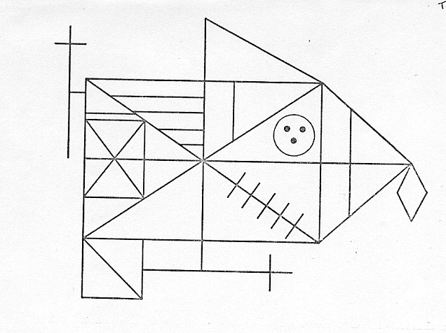
André Rey’s Complex Figure

Slide 39
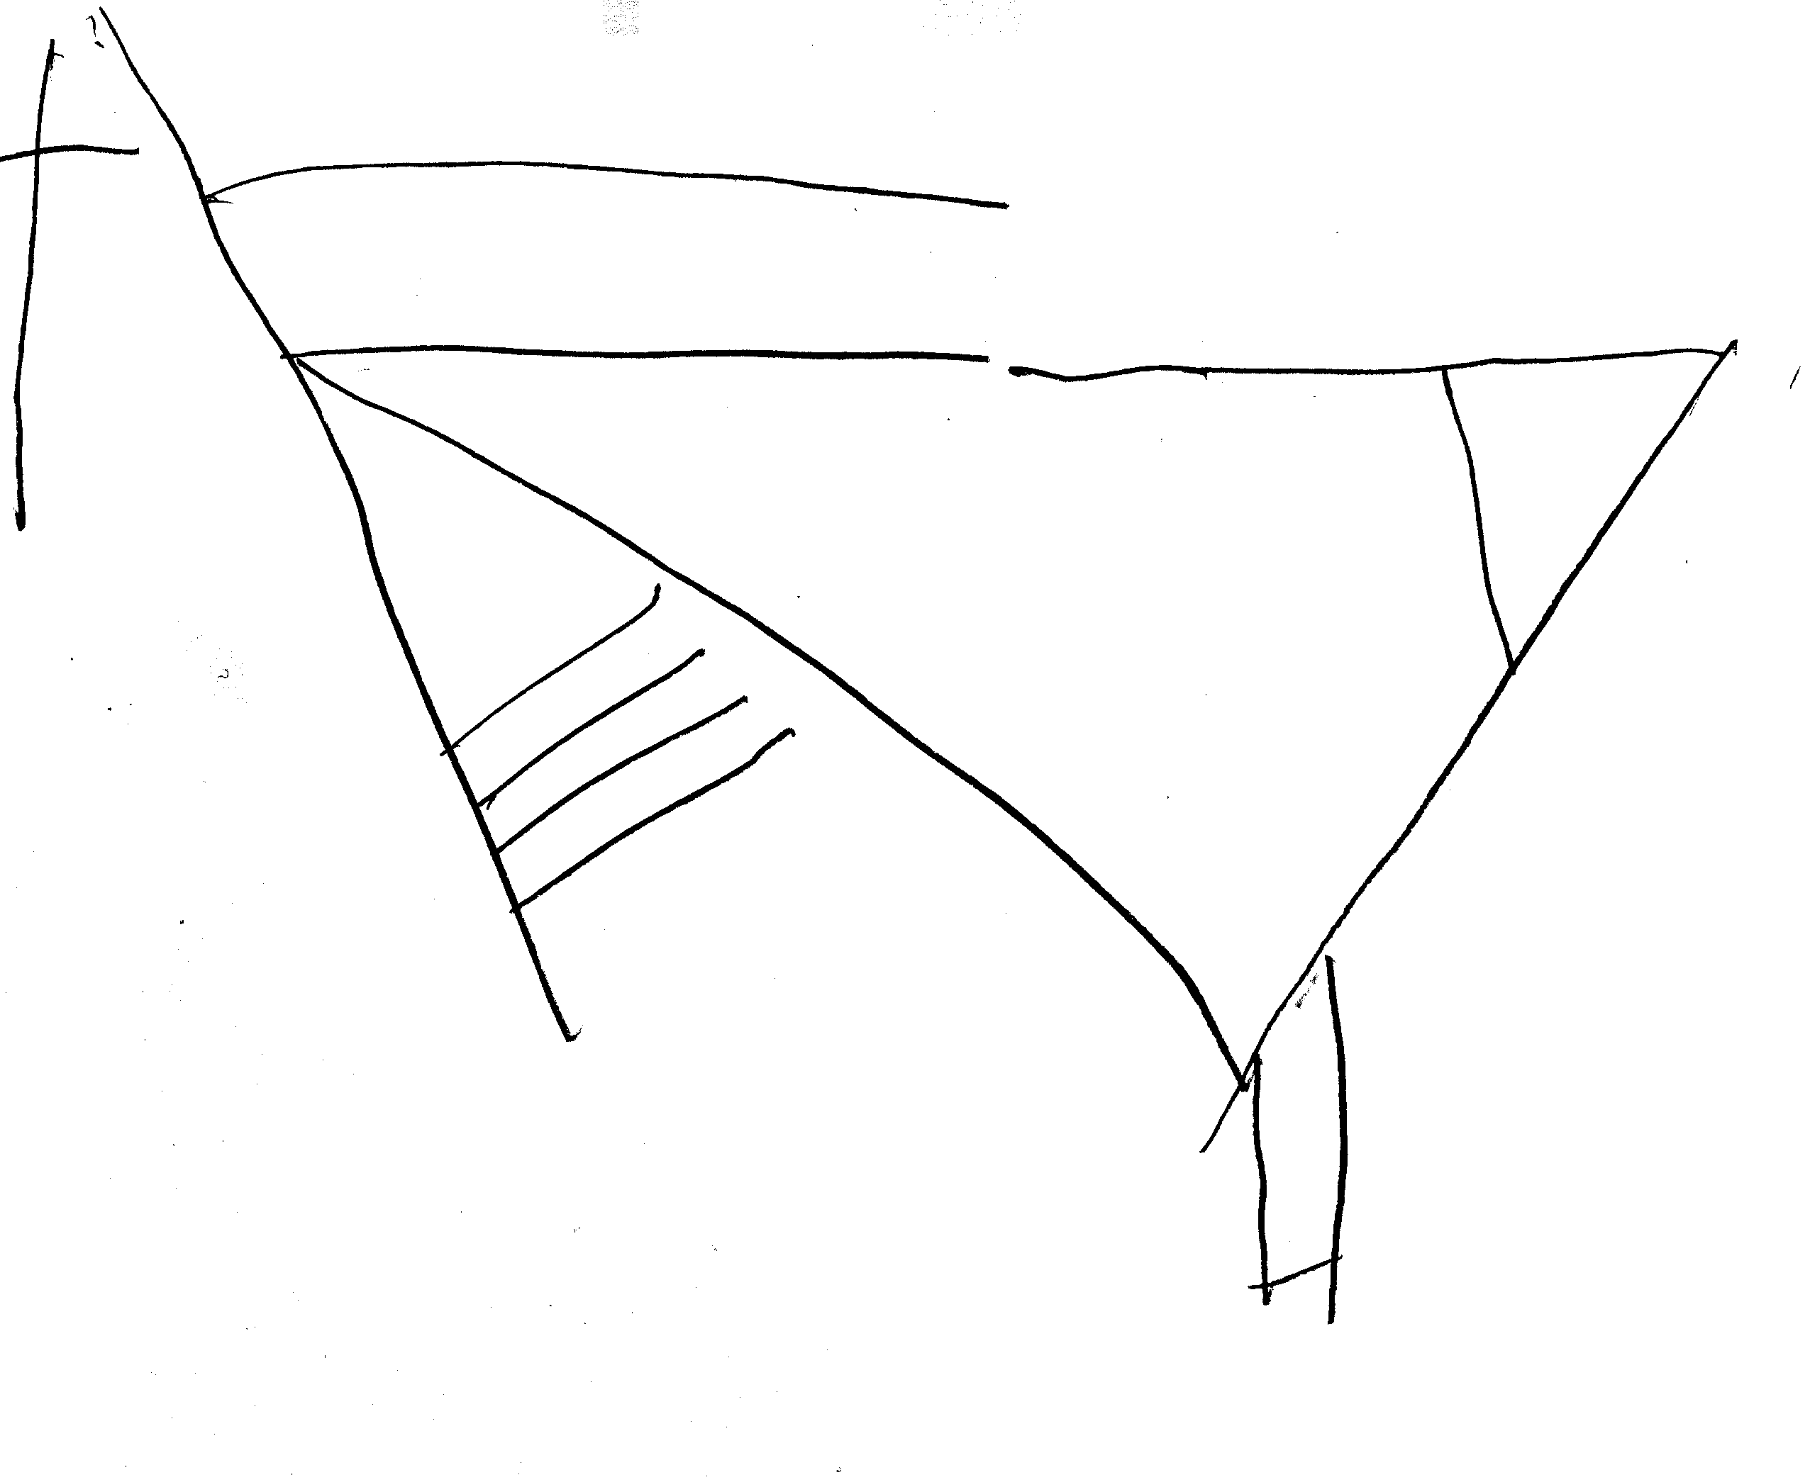
Complex Figure fm Memory, Adult with TBI

Slide 40
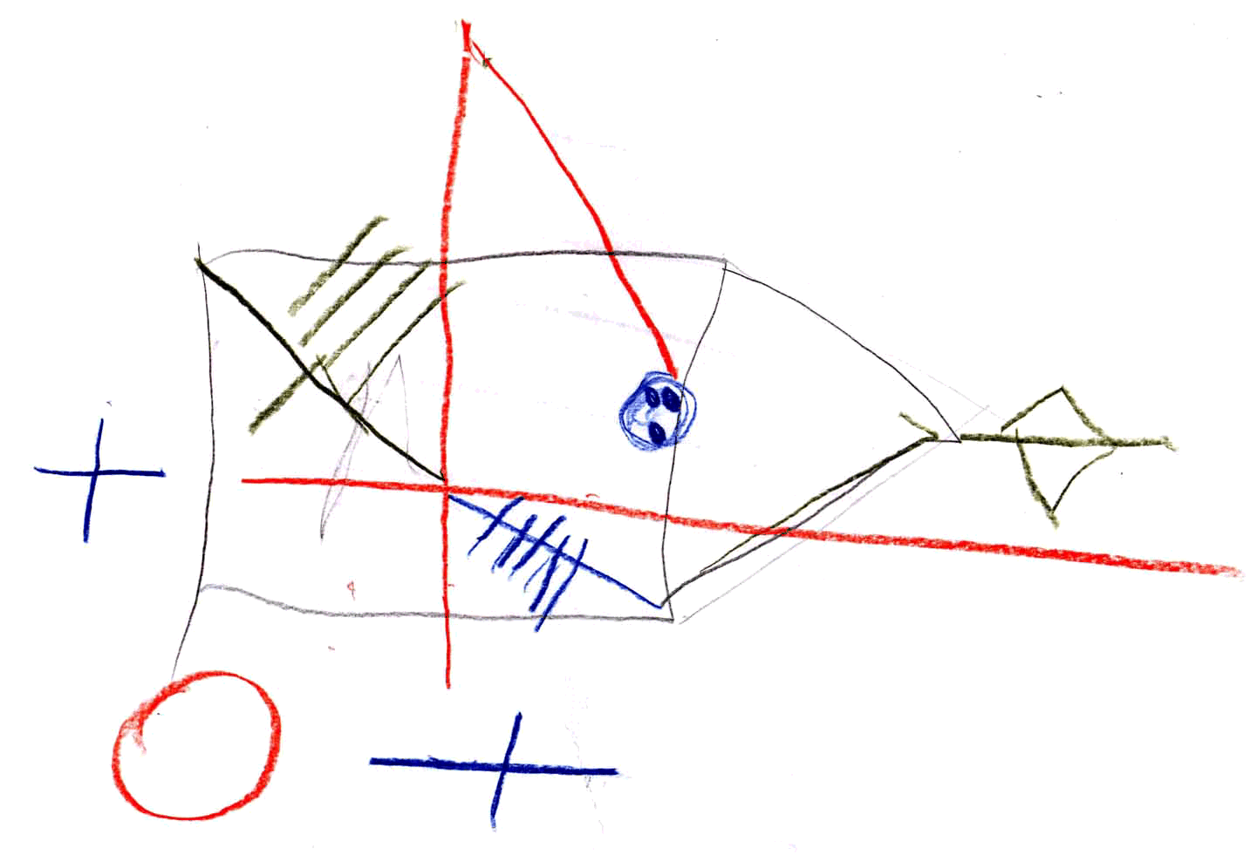
Copy from Memory after Mediation

Slide 41
Complex Figure: Effect of Mediation on Copying

Slide 42
Complex Figure: Effect of Mediation on Copy from Memory

Slide 43
RSDT: Effect of Mediation
(experimental group only)

Slide 44
Topics for 35-hr Workshop
Nature of Human Ability
Theoretical Bases of DA
Assessing Across Domains of Functioning
Assessment at Different Ages
Variety of Assessment Instruments and Materials
The Nature of the Interposed Intervention
Sources of Information Gained from DA
Interpretation, Reporting, Consultation
Research, both with and about DA

Slide 45
More on Dynamic Assessment
www.dynamicassessment.com
H. C. Haywood & C. S. Lidz (2007). Dynamic assessment in practice: Clinical and educational applications. New York: Cambridge University Press.
C. S. Lidz & J. Elliott (Eds.) (2000), Dynamic assessment: Prevailing models and applications. Amsterdam: JAI/Elsevier.
H. C. Haywood & D. Tzuriel (Eds) (1992). Interactive Assessment. New York: Springer.
Feuerstein, R. et al. (1979). Dynamic assessment of retarded performers. Baltimore: University Park Press. Revised 2002 and published by ICELP Press, Jerusalem.

Slide 46
More on Dynamic Assessment
Haywood, H. C. & Tzuriel, D. (2002). Applications and challenges in dynamic assessment. Peabody Journal of Education, 77(2), 40-63.
Lidz, C. S. (Ed.) (1987). Dynamic assessment: An interactional approach for evaluating learning potential. New York: Guilford Press.
Lidz, C. S. (1991). Practitioner’s guide to dynamic assessment. New York: Guilford Press.

