Slide 1
Shared Equity Housing: Something in between Renting and Owning
Susan Saegert, PhD
Professor and Director Center for Community Studies
Vanderbilt University

Slide 2
Overview of Talk
Ecology of Housing and Human Development
Economic Aspects of Housing
Homeownership for Low and Moderate Income Households
Foreclosure and Debt
Costs and Benefits of L/MI Homeownership
Affordable Sustainable Homeownership for Low and Moderate Income Households

Slide 3
Ecology of Housing and Human Development
Social capital
Property
Other Assets
Ethnicity
Education
Job
Social capital
Property
Other Assets
Ethnicity
Education
Job
Social &
Eco. Assets
Costs
Hazards
Stressors
G1 & G2
Health
Parenting
Support
G2 Assets
G2 Education
G1
HOME
G2
HOME
G1&G2
Housing Market
Segregation
Ownership
options
Housing Policy
Social Networks
Housing Market
Segregation
Ownership
options
Housing Policy
Social Networks
Opportunities
Networks
Racism
Community
capacity

Slide 4
Homeownership and Wealth*
For all Americans, homes rank first as contributor to wealth .
Constituted 27% of all U.S. wealth in 2001.
Ratio of wealth for homeowners to non-owners is 36:1.
For those with incomes under $20,000, the ratio is 81:1.
Housing wealth more evenly distributed across income spectrum and races than stock wealth.
Di, Z.X (2005) Does Housing Wealth Contribute to or Temper the Widening Wealth Gap in America? Housing Policy Debate, 16:281-296.

Slide 5
Housing Affordability 2009
• # households paying more than 1/2 their incomes for housing jumped from 13.8 million in 2001 to 17.9 million in 2007.
• In 2007, nearly ¾ of severely cost-burdened households had low incomes
51 % of low-income renters and 43% of low-income owners paid more than ½ their incomes for housing.
• Even if age- and race-specific cost burden shares return to 2000 levels by 2015, 16.2 million household would still be severely housing cost burdened in that year.
• Nearly ½ of working-age households with incomes between one and two times the federal minimum wage full-time equivalent spent more than half of their incomes on housing in 2007.

Slide 6
Housing Affordability 2009
No household earning the equivalent of the full-time minimum wage ($11,500) can afford a modest 2 bedroom apartment at the federal fair market rent anywhere in the US.
• Bottom 25 % devoting more than half their incomes to housing on average spent $123 less each month on food, $86 less on healthcare, and $20 less on clothing than bottom quartile households that were paying less than 30 percent of income for housing. These households had about $485 a month available for all other expenses after paying for housing.
• Even before the recession began, the share of minority homeowners with equity cushions of less than 5 % of the home’s value was twice as high as that of whites (6.9 % versus 3.4 %).

Slide 7
Racial and SES differences in Appreciation
Many studies find lower price appreciation for African Americans or in Census Tracts with increasing minority ownership
Low income owners return to renting at high rates
Appreciation of low cost homes very variable
Interest deduction not as valuable to low SES
Hi cost loans can wipe out equity and promote loss of home, return to renting

Slide 8
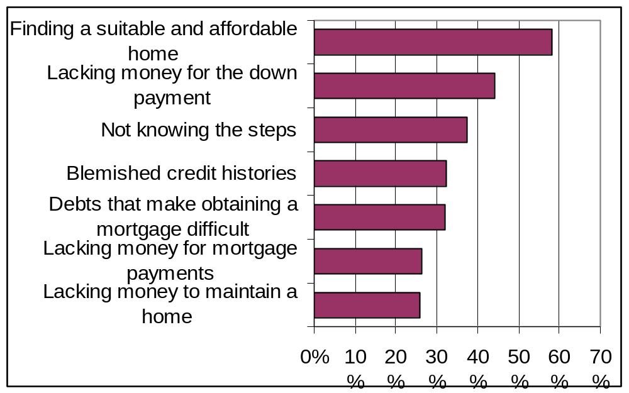
Common Barriers to Homeownership*
Saegert, Justa & Winkel (2005) survey in 2004 of 15 U.S. communities, 759 respondents, 68% homeowners, 65% minority, median income ~$30,000.

Slide 9
Our Study and the Context of the Crisis
Summer of 2006
Segmented focus groups
  9 groups with 88 homeowners
Questionnaire
Video messages
Sites included:
  Waco, TX
  Hamilton, OH
  Duluth, GA
  St. Louis, MO
  New York City, NY
Notes:
Play video messages

Slide 10
Individual Responsibility
Homeowners organize their lives around meeting their bills
“It’s very easy, you get behind, so you have to truly stay focused and prioritize exactly what you need to do, and do it.”

Slide 11
“My story’s just like hers, except”
Bodies fail, jobs disappear, hours are cut back, their family members need financial and practical assistance
Low-income homeowners pile up unavoidable debt meeting crises and lose income because they are unemployed or underemployed
They usually have the MOST resources in their network, so they can’t get help when they need it.

Slide 12
Debt Squeeze
“Being part of the working class as I would call it, it’s hard. Credit means everything and if your score is constantly at a standstill or going down, you can’t get any help.”

Slide 13
Sense of Unfairness
“Even the lender that bought my mortgage, they have automated calls that come to my home at two or three o’clock in the morning…I guess you can say that my attitude is zero because I do not understand how these large corporations and these large lenders can do poor people in the way they do them…you cross a street against the light, you’ve got a ticket. You can’t tell me what these things that the lenders, and bankers, and mortgagors do is right. It’s wrong.”

Slide 14
The Non-interventionist State
Homeowners want intervention
“When a homeowner’s home is foreclosed on, why isn’t there a system that can check the payment history ….to see if that foreclosure is justified. A lot of times homeowners lose their homes on the whims of a mortgager.”

Slide 15
The Non-interventionist State
The government sanctions rules that favor corporations
“I cut all my expenses…my mortgage payments went from 6% to 9% because I’m so far behind… And they think you can pull money out of your pocket.. I think that they should have more programs for homeowners…really wanting to try. But our government won’t let us get out of debt.”

Slide 16
Radical Risk
“It makes you fear for the risk forever. Because you realize one thing can totally wipe out everything and no one is willing to help unless you’re at, below rock bottom.”

Slide 17
Tarnished Dreams
“I’m a single female, children are adults, and I really think it is important to have property, I mean that is the American Dream but they don’t make it easy…(They say) ‘You should be able to do this.’ Well in a perfect world I’d be able to make more than $8 or $9 an hour … I’ve raised my babies. Everybody’s self-sufficient … I’m 50 years old and I’m starting from scratch.”

Slide 18
Debating Blame
“When you go to refinance or to loan, the very first question is what is your zip code, okay? ….I’m talking red lining…and they also do racial profiling.”
Vs.
“Poor people don’t have an education…that’s where the redlining comes in because people don’t know how to maintain their property.”

Slide 19
Personal Responsibility and Full Citizenship
“I can honestly say from this whole experience, when I talk to my kids now … (I) teach them to save money … teach them that credit is important … you want to go to college … I want them to be able … to be one of those people sitting on the side of the table that have the clout to negotiate what they really want up front and not have to fight for tidbits.”

Slide 20
Personal Responsibility and Full Citizenship
“I … teach my daughter now the importance of credit … but I also teach her the importance of voting … Missouri legislature, I personally believe they’re getting kickbacks from these large companies … bottom line is we need to vote these people out of here that’s not working for the people.”

Slide 21
Suggestions From the Grassroots
Timely assistance for those undone by hardships
Regulate the financial and mortgage industries effectively
Provide a safety net

Slide 22
Foreclosure
14.6 million mortgages are expected to be in default by the end of 2009 (Manning, 2009)
Foreclosures decrease property values and increase crime in neighborhoods (Immergluck& Smith, 2006a and b)
Cost municipalities money and reputation (Apgar & Duda, 2006)
Minority households disproportionately impacted by high cost loans and foreclosure(SNH 2009)
Notes:
SHOW VIDEO CLIP

Slide 23
Homeownership, Debt and Foreclosure
Debt and Foreclosure
Benefits of homeownership (often slim or confounded)
Satisfaction with dwelling
Self esteem /Self efficacy
Higher general health ratings
Positive effects on child development and later life (reflects residential stability, wealth accumulation, and perhaps other things)
Lower sense of security
Depression
Family tension and marital disruption
Decreases in physical and mental health
Bad credit, bankruptcy, diminished opportunities

Slide 24
Homeownership, Debt and Foreclosure (Community Level)
Benefits of homeownership
Debt and Foreclosure
Better home maintenance (related to neighborhood conditions)
High homeownership in area = higher property values
More civic engagement
Increases in racial and economic segregation
Less Crime
Longer length of residence (relates to lower crime)
Lower income and minority owners less likely to move when neighborhood deteriorates
High foreclosure= lower property values
Lowers maintenance
High costs to municipalities (services, lost taxes, legal costs)
Abandoned buildings related to more crime

Slide 25
Supply and Cost Issues
Homeownership
Rental Housing
Rapid price appreciation until 2006 then flat then dropped in 2009
After expansion of lending thru subprime, credit has contracted
Housing starts have dropped
Equity has dropped 41% (2009)
Shortage of low cost units has increased for 2 decades
Construction of new units mostly in higher cost brackets
10% vacancy 2008

Slide 26
Homelessness Rising
A January 2007 count put the number of homeless at 671,888. Two-fifths of the homeless were sleeping on the street or in other places unfit for human habitation. More than a third of the homeless were members of families with children.
The New York Times on Oct. 19 2009 reports rise in shelter entries caused by foreclosure to 10% from 0% last year.

Slide 27
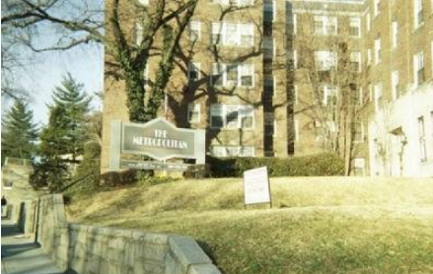
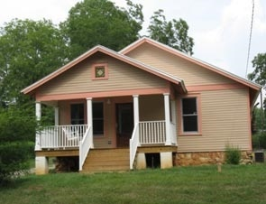
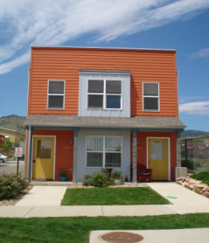
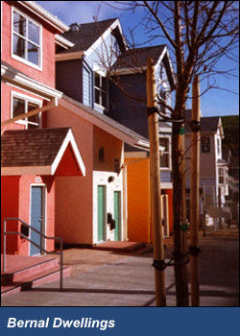
What is shared equity housing?
A form of resale-restricted, owner-occupied housing where the resident partially owns the home or property.
3 MODELS:
Limited Equity Cooperatives (LEC):
buys shares in a cooperative that owns the housing
≈ 500,000 units, most developed in 1960-70s
Community Land Trusts (CLT):
buys the home, leases the land
≈ 200 CLTs, ≈ 10,000 units, started in 1970s and doubled since 2000
Deed-Restricted Housing (DRH):
buys the home with restricted covenant on the property deed
≈ 500 DR programs, ≈ 50,000 units, took off since 2000
LEC Washington, D.C.
CLT Athens, GA
DRH Boulder, CO San Francisco, CA

Slide 28
How is Shared Equity Implemented?
The Local Steward:
to monitor and maintain permanent affordability
to manage assets
to advocate, market, and promote public policies that facilitate the success of shared equity locally and nationally
Sale of a Shared Equity home:
Index-based formula
Mortgage-based formula
Appraisal-based formula
Notes:
The Local Steward:
A local steward is an organization that supports residents, developers, and the broader community to create, sustain, and maintain shared equity housing. They assume three major responsibilities:
to monitor and maintain permanent affordability
to manage assets
to advocate, market, and promote public policies that facilitate the success of shared equity locally and nationally
Sale of a Shared Equity home:
A limited-appreciation formula is used to establish a ceiling for the resale price, which preserves affordability for the next buyer. These formulas typically allow the SE seller to recover their down payment, expenses on capital improvements, and a reasonable return on the investment. Three techniques used to establish the limited-appreciation formula are:
Index-based formula
Mortgage-based formula
Appraisal-based formula
Make is a point when discussing the formulas to note that you are really just sharing the appreciation, not the equity that one has put into the house. The steward keeps their equity, or subsidy, and the homeowner keeps their equity, or down payment and the amount they have paid off of the principal.

Slide 29
How does SE housing compare to renting or market-rate home owning?
Renting
Home owning
Dilapidated housing
Unresponsive landlords
Unstable rent and tenure
No equity accumulation
Control over home
Pays for home repairs
Must pay mortgage
Accumulates equity
Shared Equity Home owning
Control over high quality home
Pays for home repairs
Must pay affordable & stable mortgage
Accumulates some equity
Notes:
ANIMATED SLIDE
[CLICK] Discuss issues with renting
[CLICK]Then discuss benefits of owning a home, but then tell story with visual effects:
[CLICK] if mortgage can’t be paid (adjustable rate mortgages, subprime lending, threat of foreclosure etc.)
[CLICK] makes it hard to keep up the home (pay for home repairs, which decreases the value),
[CLICK] which means that the homeowners is accumulating less equity or ultimately loses equity in the instance of foreclosure or volatile markets
[CLICK] and ultimately they lose the control over their home and have not seen an improvement in the quality of their lives.
[CLICK] Discuss how SE protects resident from these problems with assurance of a return on investment.

Slide 30
How does SE housing programs uniquely contribute to affordable housing?
Creates permanent affordable housing stock
Preserves public subsidy
Provides good return on investment for resident
Allows homeownership programs to reach lower income levels
Provides “safer” and more “secure” form of homeownership
Promotes better maintenance of units over time through management
May facilitate resident engagement and community control

Slide 31
Home in the Private Market
$$$$
Notes:
Just to make this a little easier to understand, here are some pictures to show you what SE is. (Pic 1) So let’s say this is a home for sale in the private market, which is being sold for some amount that is represented by the four dollar signs above the house.

Slide 32
Mortgage for the Home in the Private Market
$$$$
$$$$
Homeowner
Notes:
(Pic 2) If you wanted to buy this home in the private market then you must cover the entire cost of the house, which means that you must pay some money up front in a down payment and you must qualify and receive a mortgage for the amount of the home. But, getting a mortgage for this amount can be out of reach for some people.

Slide 33
Subsidy of the Shared Equity Home
$$$$
$
Organization
Notes:
(Pic 3) Now if this was a SE home, an organization that’s either a non-profit or a part of government puts in a substantial amount of money upfront, which is called a subsidy. This subsidy lessens the price of the home now when the buyer enters the picture.

Slide 34
Mortgage for the Shared Equity Home
$$$$
$$$
Homeowner
$
Organization
Notes:
(Pic 4) So, if you wanted to buy this home, now you have to get a mortgage for less money than you did when the house was in the private market, since the organization has put some money into the home. So let’s say you buy the home…

Slide 35

5, 10, or 20 years passes….
Notes:
(Pic 5) …you live there, and you pay your mortgage payments and maintain the home for some years.

Slide 36
The Homeowner Paid Off Some of the Mortgage & The Home Has Appreciated in Value
$$$$+ $_{Appreciation}
FOR SALE
$$
Homeowner
$
Organization
Notes:
(Pic 6) And now you are ready to sell your home. Well, since you have been paying off your mortgage, you have paid off some of the principal, which is the amount of equity you have in the home. That means you and the organization both have equity in the home now. Plus, the house is worth more money than when you bought it because it has appreciated over time.

Slide 37
The Appreciation is Shared
$$$$+ $_{Appreciation}
$ _{Appreciation}
SOLD
$ _{Appreciation}
$$$
Homeowner
$
Organization
Notes:
(Pic 7) So when you sell your home to a new buyer—just like owning in the private market— you walk away with what you have paid off in the principal, and you also walk away with some of the money from the home appreciating in value. BUT unlike the private market, you don’t get all of the profit from the home appreciating in value because the organization also has equity in the home from the money they put in upfront to make it more affordable for you. So the organization gets to keep their subsidy and they get some of the money made from appreciation too. Remember this organization is a non-profit or government, so they are not doing this to make money. Instead, what they will do is keep that subsidy in the home and add to the money they get from their share of the appreciation. That way, the subsidy will grow and keep pace with the market so the new buyer will also be able to afford this home. Does that make sense?

Slide 38
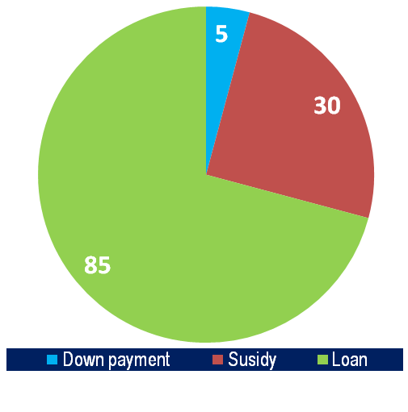
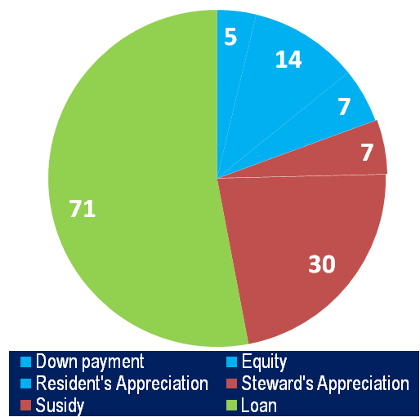
How does sharing appreciation work?
Purchase: 120 K
Sale: 134 K
10 years later
3% annual appreciation
30 year mortgage
6% interest rate
LOCAL STEWARD REINVESTS…
7,000 (50% of appreciation)
30,000 (pre-existing subsidy)
$37,000 TOTAL
HOME OWNER WALKS AWAY WITH…
7,000 (50% of appreciation)
5,000 (down payment)
14,000 (paid off principal)
4,000 (closing costs)
$22,000 TOTAL
Notes:
This example is based upon the numbers that are being considered by the Nashville SE initiative. Obviously, these are locally specific numbers in terms of housing values, amount of subsidization, annual appreciation estimates, and the percentage split of the appreciation between the steward and resident. Most SE programs that use an appreciation-based resale formula give the owner 25% but Nashville is considering giving a higher percentage of appreciation to residents.
Therefore, this illustration shows that if a home is bought at 120, 000 dollars, where the local steward contributed 30 K in subsidy and the owner contributed a 5 K down payment. Then after 10 years, under these conditions (i.e. 3% compounded annual appreciation, 30 year amortized mortgage, and a 6% interest rate) the home would be worth 134 K. The resident would recoup their down payment (5 K), the amount paid of the principal (14 K), and make 50% of the appreciation (7 K). After closing costs then, they would walk away with 22 K of equity. The local steward would then reinvest the 7 K of their share of the appreciation back into the property to maintain affordability for the next resident or invest the money in the SE program.

Slide 39
Bringing it all together:
The Transformative Potential of Shared Equity
Individual/ household
Community Development
National Economy
To improve the quality of life for individuals through safe living conditions, wealth-accumulation, and increased well-being and liberty
To develop disenfranchised communities through civic engagement, social capital, and neighborhood investment
To promote more local control of capital investment in housing
Notes:
Turning the discussion back over to Susan now, I would like to leave up this framework to conceptualize the transformative potential for SE housing. It is important to recognize that transformation on any one of these levels does not preclude or necessitate transformation on other levels.

